Slide 1
INTRODUCTION to ELECTRONICS (10958)
Assoc. Prof. Dr. Hacer Atar Yıldız
E-mail: haceryildiz@itu.edu.tr
Room: 3104
Teaching Assistant:

Slide 2
Course Weekly Lecture Plan
Weeks | Topics
1 | Introduction, overview of topics, overview of basic knowledge required for this course
2 | Atomic models, crystal structure, semiconductor physics, doping, current flow mechanisms, Continuity Equation
3 | pn junction, currents in unbiased pn junction, formation of depletion layer, carrier density diagrams, derivation of potential barrier and depletion layer thickness, and Semiconductor Diode Equation.
4 | Types of diodes, Zener effect, Zener diodes, diode capacities, sample circuits constructed with diodes
5 | Transistor physics, physical characteristics of BJT, biasing conditions, current components, transistor parameters
6 | BJT as a switch and biasing for analog applications
7 | Midterm Exam 1 (12 November 2024)
8 | Transistor amplifier circuits: equivalent AC circuits, small signal analysis
9 | Transistor amplifier circuits: gain and input/output resistance calculations, cascade amplifier circuits
10 | Differential amplifier circuits: configurations, gain and input/output resistance and CMRR calculations
11 | MOSFET, physical characteristics. MOS as a switch and biasing for analog applications
12 | Midterm Exam 2 (24 December 2024)
13 | Transistor amplifier circuits: MOS amplifiers
14 | Operational Amplifiers (OPAMP) and applications

Slide 3
Grading
Midterm Exams 2x 30%, Final Exam 40%
To be eligible of taking the final, at least one mıdterm exam should be taken, with a minimum MIDTERM EXAM AVERAGE of 25/100..(the sum of your grades from MT exams should be 50/200 or more; i.e. {MT1+MT2} ≥ 50)
I created a Ninova page for your section. You can access it using your ITU student account and password.

Slide 4
Textbooks
Microelectronic Circuits, A.S. Sedra, K.C. Smith, OxfordUniversity Press, 2003. ISBN: 0-19-514252-7.
Fundamentals of Microelectronics by Behzad Razavi (Author)
Elektronik Elemanları, D. Leblebici, SEÇ Yayın Dağıtım, Istanbul, 2001. ISBN: 975-7670-32-4.
Elektronik, M. Sait Türköz, Birsen Yayınevi, 2004, ISBN: 975-511-198-0;
Elektronik Devre Elemanları, Avni MORGÜL, PapatyaBilim, 2016.

Slide 5
Introduction to Electronics
Introduction
Semiconductors & Doping, Basics of pn junction
Diodes
BJT Transistors
MOSFET Transistors
Operational Amplifiers

Slide 6
Engineering Notation Scientific Units – positive powers
Power | Number | SI symbol | SI prefix
0 | 1 | (none) | (none)
3 | 1,000 | k | kilo
6 | 1,000,000 | M | mega
9 | 1,000,000,000 | G | giga
12 | 1,000,000,000,000 | T | tera
15 | 1,000,000,000,000,000 | P | peta

Slide 7
Engineering Notation Scientific Units – negative powers
Power | Number | SI symbol | SI prefix
0 | 1 | (none) | (none)
−3 | 0.001 | m | milli
−6 | 0.000 001 | μ | micro
−9 | 0.000 000 001 | n | nano
−12 | 0.000 000 000 001 | p | pico
−15 | 0.000 000 000 000 001 | f | femto

Slide 8
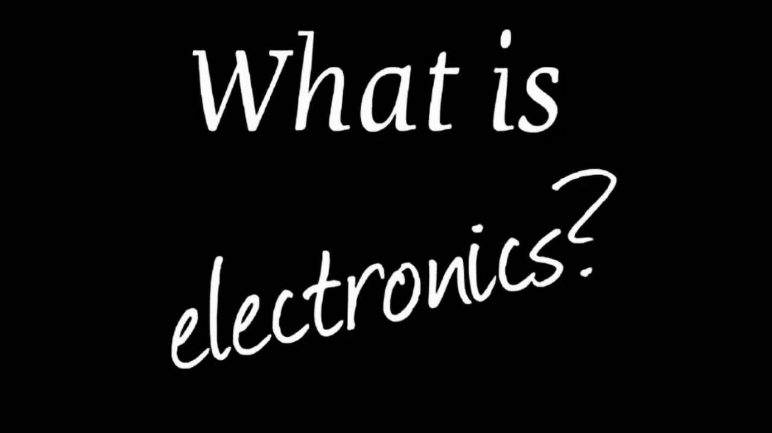

Slide 9
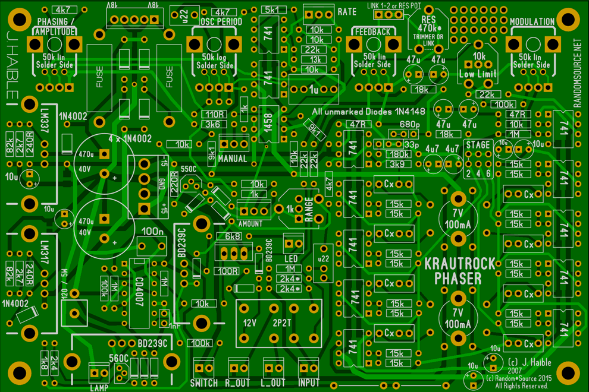
What is electronics?
The branch of engineering in which the flow and control of electrons in vacuum or semiconductor are studied is called electronics.
Electronics can also be defined as the branch of engineering in which the electronic devices and their utilization are studied.
Electronics have various branches include, digital electronics, analog electronics, micro electronics, nanoelectronics, optoelectronics, integrated circuit and semiconductor device.

Slide 10
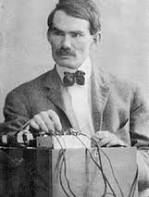
History of Electronic
Lee de Forest (August 26, 1873 – June 30, 1961) was an American inventor and scholar.
He made significant contributions to the science of electronic communications during the first three decades of the Twentieth Century. He held numerous patents on the technology of radio, television and film.
His most famous invention, in 1906, was the three-element "Audion" (triode) vacuum tube, the first practical amplification device.
Vacuum tubes played a major role in the field of microwave and high power transmission as well as television receivers.

Slide 11

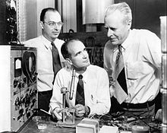
In 1947, Bell laboratories developed the first transistor based on the research of Shockley, Bardeen and Brattain.
In 1959, Jack Kilby of Texas Instruments developed the first integrated circuit.
Integrated circuits contain large number of semiconductor devices such as diodes and transistors in very small area.

Slide 12
Basic Semiconductor Physics
Semiconductors
Intrinsic (undoped) silicon
Doping
Carrier concentrations

Slide 13
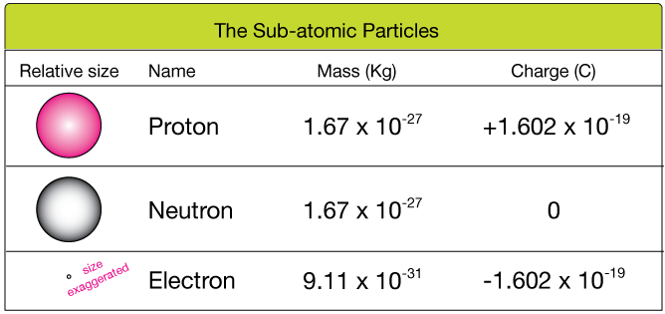
What is Electricity?
Atoms contain
Protons (+)
Neutrons (0)
Electrons (-)
Protons are positively charged and electrons are negatively charged.
The unit of charge is Coulomb (C)

Slide 14
Sign Convention for Current Flow
Electrons carry negative charge
Current flow is in opposite direction
-
-
-
-
-
-
-
-
-
-
-
-
-
-
-
-
-
-
-
-
-
-
-
-
electron motion
Current direction

Slide 15
Current Flow
The direction of current flow is indicated by an arrow.
DC Voltage Source
+
_
higher potential
Note: The voltage sources in the circuit flow current through nodes and wires.
Current flow is from a higher potential (voltage) to a lower potential (voltage).

Slide 16
Electric Circuit
If two or more nodes are connected just by wires, intersection point can be considered as one single node.
Intersection point of wires is call as a node
Nodes are Connected
by Wires Only
A single node
One big node
Electronic elements
Conducting wires
+
_
Group of nodes connected only by wires
One big node

Slide 17
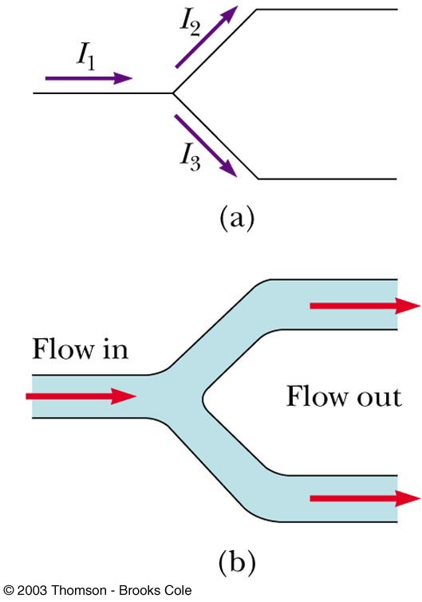
From Conservation of Charge
Current is the amount of electric charge (coulombs) flowing through a cross section of a conductor in one second
The sum of charges flowing into a node must be equal to the sum of the charges flowing out of the node.
I₁ = I₂ + I₃
Diagram b shows a mechanical analogy

Slide 18
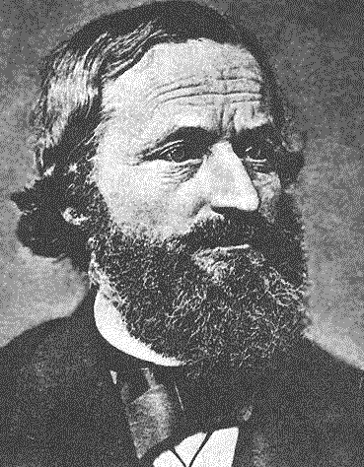
Kirchhoff’s Current Law
The sum of currents flowing into a node must be balanced by the sum of currents flowing out of the node.
i₁
node
i₂
i₃
Gustav Kirchoff was an 18th century German mathematician
+
_
i₁ flows into the node
i₂ flows out of the node
i₃ flows out of the node
i₁ = i₂ + i₃

Slide 19
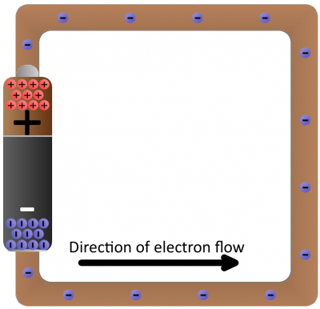
Voltage (Difference in energy level )
Voltages are measured across the nodes of a circuit.
The direction of a voltage is indicated by + and – signs.
+ v₂ –
+
v₁
–
+
v₃
–
+
v₄
–
+
_
higher potential
lower potential

Slide 20
Kirchhoff’s Voltage Law
The voltage measured between any two nodes does not depend of the path taken.
voltage
+ v₂ –
voltage
+
v₁
–
+
v₃
–
+
v₄
–
+
voltage
_
Example of KVL:
v₁= v₂ + v₃
Similarly:
v₁= v₂ + v₄
and:
v₃= v₄

Slide 21
Kirchhoff’s Voltage Law: v₁ = v₂ + v₃
This equation can also be written in the following form:
–v₁ + v₂ + v₃ = 0
+ v₂ –
+
v₁
–
+
v₃
–
+
v₄
–
+
_
A formal statement of Kirchhoff’s Voltage Law:
The sum of voltages around a closed loop is zero.

Slide 22
Using the Formal Definition of KVL
“The sum of voltages around a closed loop is zero.”
Define an arrow direction around a closed loop.
Sum the voltages that are encountered around the loop.
If the arrow first encounters a plus sign, enter that voltage with a (+) into the KVL equation.
If the arrow first encounters a minus sign, enter that voltage with a (–) into the KVL equation.
+ v₂ –
+
v₁
–
+
v₃
–
+
v₄
–
+
_
For the inner loop :
–v₁ + v₂ + v₃ = 0
For the outer loop:
–v₄ – v₂ + v₁ = 0

Slide 23
The Capacitor
Capacitors are one of the fundamental passive components. In its most basic form, it is composed of two conducting plates separated by a dielectric material.
The ability to store charge is the definition of capacitance.
Conductors
Dielectric

Slide 24
Initially uncharged
capacitor

Slide 25
Charging

Slide 26
Fully charged
After fully charged, a capacitor behaves as an open circuit and does not allow current flow.

Slide 27
Source removed
A capacitor with stored charge can act as a temporary battery.

Slide 28
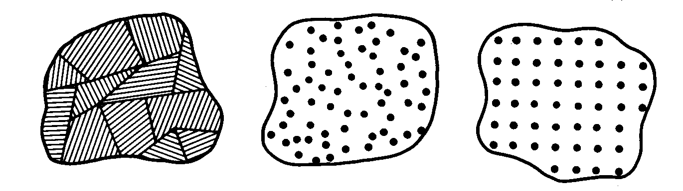
What is a Semiconductor?
Low resistivity => “conductor”
High resistivity => “insulator”
Intermediate resistivity => “semiconductor”
conductivity lies between that of conductors and insulators
generally crystalline in structure for IC devices
In recent years, however, non-crystalline semiconductors have become commercially very important
polycrystalline amorphous crystalline

Slide 29
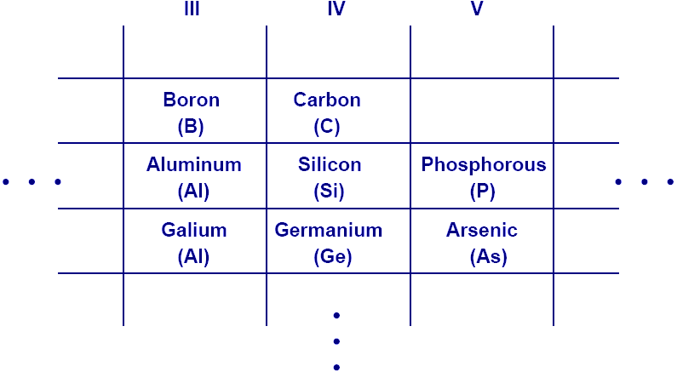
Semiconductor Materials
Phosphorus
(P)
Gallium
(Ga)
Use the periodic table to find the number of valance electrons.
Group 4 = 4 Valance electrons

Slide 30
Why is Silicon Used?
Silicon is a semiconductor.
Silicon’s electrical properties can be modified through a process called doping.
Silicon is also an abundant element on Earth.
The abundance of Si allows it to be extremely affordable and appealing

Slide 31
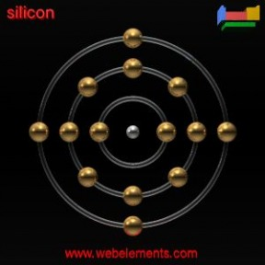
Silicon
Silicon is element 14 in the Periodic Table
It has two electrons in its first shell, eight electrons in the second shell, and four electrons in the third shell.
Since the electrons in the third shell are the outermost electrons, silicon has four valence electrons.
The valence electrons are the electrons that determine the most typical bonding patterns for an element.

Slide 32
Conduction in Semiconductors
Semiconductors (Si) act as insulators at low temperatures and conductors at higher temperatures.
Conduction occurs at higher temperature because the electrons surrounding the semiconductor atoms can break away from their covalent bond and move freely about the lattice

Slide 33
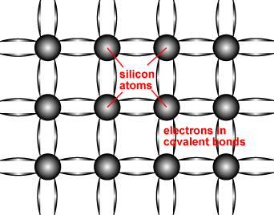
Semiconductor structure
A covalent bond consists of two atoms "sharing" a single electron.
Each atom forms 4 covalent bonds with the 4 surrounding atoms.
Therefore, between each atom and its 4 surrounding atoms, 8 electrons are being shared.

Slide 34
Electronic Properties of Si
• There are 2 types of mobile charge-carriers in Si:
Conduction electrons are negatively charged;
Holes are positively charged.
• The concentration (#/cm³) of conduction electrons & holes in a semiconductor can be modulated in several ways:
by adding special impurity atoms ( dopants )
by applying an electric field
by changing the temperature
by irradiation

Slide 35
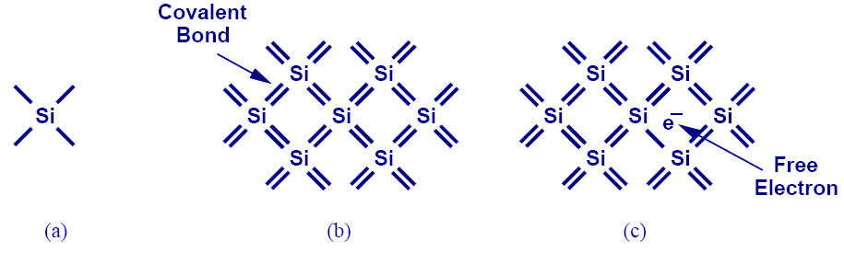
Silicon
Atomic density: 5 x 10²² atoms/cm³
Si has four valence electrons. Therefore, it can form covalent bonds with four of its nearest neighbors.
When temperature goes up, electrons can become free to move about the Si lattice.

Slide 36
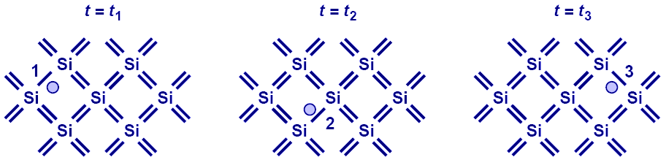
Electron-Hole Pair Generation
When a conduction electron is thermally generated, a “hole” is also generated.
A hole is associated with a positive charge, and is free to move about the Si lattice as well.

Slide 37
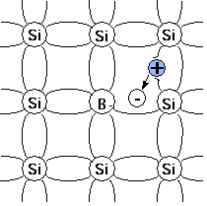
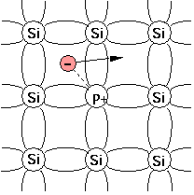
Semiconductor
Energy band structure of different matters
conductive band
energy band structure : metal, semiconductor, insulation
An intrinsic semiconductor, also called an undoped semiconductor, is a pure semiconductor without any significant dopant species present.
doping (extrinsic semiconductor ) : p-type, n-type
Eg
energy gap
valence band
metal
Semiconductor
Eg ~ 1~3 eV
insulation
doping
P-type (IIIA) (acceptor)
N-type (VA) (donor)

Slide 38
Carrier Concentrations in Intrinsic Si
The “band-gap energy” E_{g} is the amount of energy needed to remove an electron from a covalent bond.
The concentration of conduction electrons in intrinsic silicon, n_{i}, depends exponentially on E_{g} and the absolute temperature (T):

Slide 39
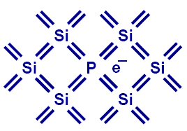
Doping (N type)
Si can be “doped” with other elements to change its electrical properties.
For example, if Si is doped with phosphorus (P), each P atom can contribute a conduction electron, so that the Si lattice has more electrons than holes, i.e. it becomes “N type”:
Notation:
n = conduction electron
concentration

Slide 40
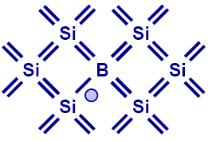
Doping (P type)
If Si is doped with Boron (B), each B atom can contribute a hole, so that the Si lattice has more holes than electrons, i.e. it becomes “P type”:
Notation:
p = hole concentration

Slide 41
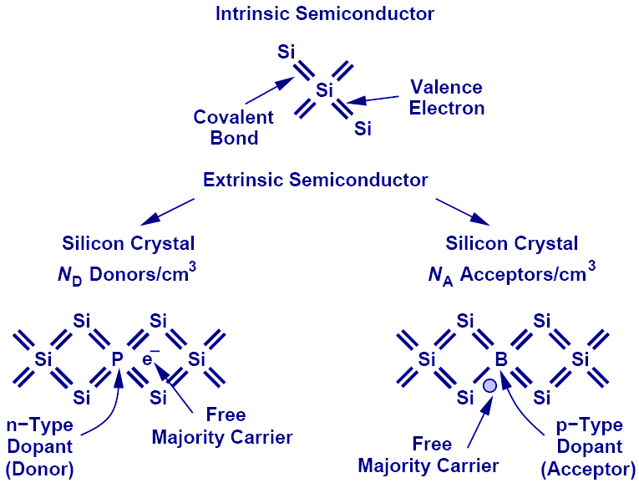
Summary of Charge Carriers

Slide 42
Electron and Hole Concentrations
Under thermal equilibrium conditions, the product of the conduction-electron density and the hole density is ALWAYS equal to the square of n_{i}:
N-type material
P-type material

Slide 43
Terminology
donor: impurity atom that increases n
acceptor: impurity atom that increases p
N-type material: contains more electrons than holes
P-type material: contains more holes than electrons
majority carrier: the most abundant carrier
minority carrier: the least abundant carrier
intrinsic semiconductor: n = p = n_{i}
extrinsic semiconductor: doped semiconductor

Slide 44
Summary
The band gap energy is the energy required to free an electron from a covalent bond.
E_{g} for Si at 300K = 1.12eV
In a pure Si crystal, conduction electrons and holes are formed in pairs.
Holes can be considered as positively charged mobile particles which exist inside a semiconductor.
Both holes and electrons can conduct current.
Substitutional dopants in Si:
Group-V elements (donors) contribute conduction electrons
Group-III elements (acceptors) contribute holes
Very low ionization energies (<50 meV)

